Slide 1

TECH19599 Exploring Information Technology
Mobile Application Development
(Control Statements)

Slide 2
Goals of This Module
Create more complex Apps.
Use different events.
Learn how to program more complex logic.
Turn the Tic Tac Toe front end into a working App

Slide 3
Evaluation for This Module
In class exercises
3 marks
Completing Tic Tac Toe project
10 marks

Slide 4
Review Exercise
Make an Application for Heads or Tails Game
Hint: Remember the Dice game
When you click the button it shows 1 or 2 (randomly)

Slide 5
Overview
So far our applications were simple
We started from a set of inputs and executed to the end always the same way (for different inputs).
What if based on some decisions programmer wants to change the execution path
For example show different images based on different values in Heads or Tails app

Slide 6
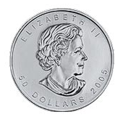

Overview
Generate 1 or 2 randomly
If it is 1
Yes
No
Show
Show

Slide 7
Overview
How?
We call these selection (control) statements
Selection is made based on certain conditions
Example: The randomly generated value equals 1

Slide 8






Comparison Operators
Operator | Description
 | Less than
 | Less than or equal to
 | Greater than
 | Greater than or equal to
 | Equal to
 | Not equal to

Slide 9



Example
coin = 1
age <= 30
income > 25000

Slide 10
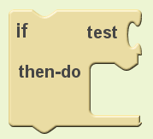
Selection Statements
Control blocks
If something is true then do this
How?
Test the Condition
Do this if the condition is true

Slide 11
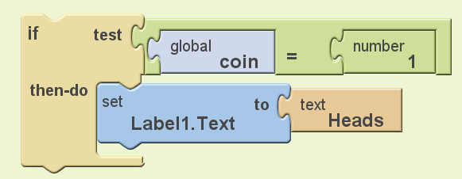
Example

Slide 12
Selection Statements
Test the Condition
Do this if the condition is true
What happens if the condition is not true?
Nothing

Slide 13
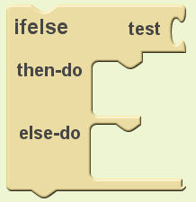
Selection Statements
What happens if the condition is not true?
Nothing
What if we want to make something happen
Test the Condition
Do this if the condition is true
Do this otherwise

Slide 14
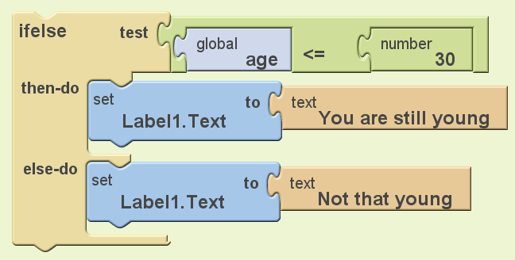
Example

Slide 15
Now Your Turn
Develop a simple app which says if an a number is positive of negative
Modify the Heads or Tail App with proper icons

Slide 16
ListPicker
In mobile apps users often need to select from list of options
Example: The user wants to pick the type of credit card (Master, Visa, AMEX)
We use ListPicker to develop this functionality

Slide 17
ListPicker
How?
In App Inventor
You need to add a ListPicker element
In Block Editor
You need to specify the options
You need to implement what will happen if the user select one of the options

Slide 18
ListPicker
Let’s develop an app which gives the user to choose from the list of fruits and simple output the name of the fruit
Specifying the options
Apple
Orange
Banana
What happens if the user pick an item
Output the name of the element

Slide 19
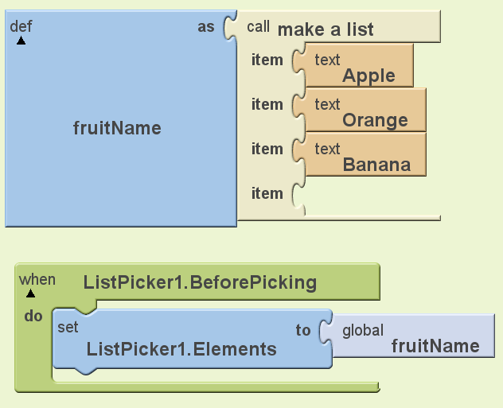
Specifying the Options

Slide 20
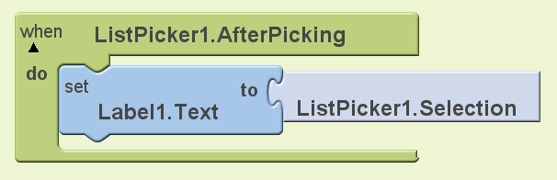
Action

Slide 21
Now Your Turn
Modify your math helper app from last class:
Add a ListPicker giving the user the option of choosing lb->Kg or inches->Cm conversion options
Using control blocks perform the correct conversion

Slide 22
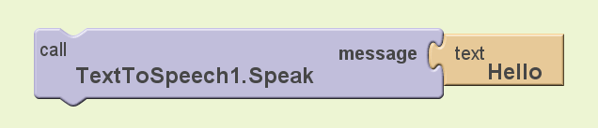
How to Make Your App Talk!
In App Inventor add a TextToSpeech element
In Block Editor

Slide 23
Exercise
Make your fruit selector App to say the name of the selected fruit
Add a button that say the name of the fruit when it is pressed

